Slide 1

Resugaring: Lifting Languages through Syntactic Sugar
Thesis Proposal
Justin Pombrio
Brown University
Committee
Mitchell Wand
Eelco Visser
Shriram Krishnamurthi
Notes:
Attribution Note: Many of these slides were storyboarded by me, and then constructed by Shriram.

Slide 3
Desugaring in Languages
Most famously in Lisp family:
(define-syntax let
(syntax-rules ()
[(let ((v e) …) b …)
((lambda (v …) b …) e …)]))

Slide 4



x + 2
desugar
x.__add__(2)
[x*x | x <- l]
desugar
map (\x -> x*x) l
desugar
x or y
let t = x in if t then t else y

Slide 5
What’s Not to Like?

Slide 6
typedef map<int, double> valmap;
valmap m;
for (int i = 0; i < NVALS; i++)
m.insert(make_pair(values[i], pow(values[i], .5)));
valmap::iterator it = 100;
valmap::iterator it2(100);
m.insert(1,2);
rtmap.cpp: In function `int main()':
rtmap.cpp:19: invalid conversion from `int' to `
std::_Rb_tree_node<std::pair<const int, double> >*'
rtmap.cpp:19: initializing argument 1 of `std::_Rb_tree_iterator<_Val, _Ref,
_Ptr>::_Rb_tree_iterator(std::_Rb_tree_node<_Val>*) [with _Val =
std::pair<const int, double>, _Ref = std::pair<const int, double>&, _Ptr =
std::pair<const int, double>*]'
rtmap.cpp:20: invalid conversion from `int' to `
std::_Rb_tree_node<std::pair<const int, double> >*'
rtmap.cpp:20: initializing argument 1 of `std::_Rb_tree_iterator<_Val, _Ref,
_Ptr>::_Rb_tree_iterator(std::_Rb_tree_node<_Val>*) [with _Val =
std::pair<const int, double>, _Ref = std::pair<const int, double>&, _Ptr =
std::pair<const int, double>*]'
E:/GCC3/include/c++/3.2/bits/stl_tree.h: In member function `void
std::_Rb_tree<_Key, _Val, _KeyOfValue, _Compare, _Alloc>::insert_unique(_II,
_II) [with _InputIterator = int, _Key = int, _Val = std::pair<const int,
double>, _KeyOfValue = std::_Select1st<std::pair<const int, double> >,
_Compare = std::less<int>, _Alloc = std::allocator<std::pair<const int,
double> >]':
E:/GCC3/include/c++/3.2/bits/stl_map.h:272: instantiated from `void std::map<_
Key, _Tp, _Compare, _Alloc>::insert(_InputIterator, _InputIterator) [with _Input
Iterator = int, _Key = int, _Tp = double, _Compare = std::less<int>, _Alloc = st
d::allocator<std::pair<const int, double> >]'
rtmap.cpp:21: instantiated from here
E:/GCC3/include/c++/3.2/bits/stl_tree.h:1161: invalid type argument of `unary * ‘
Notes:
https://www.bdsoft.com/dist/gcc-demo.txt

Slide 7
(;module: {#;doc "This will be our program's main module."}
lux
(lux (codata io)
(control monad)
[cli #+ program:]))
(program: args
(do Monad<IO>
[(io (log! "Hello, "))
(io (log! "world"))]
(wrap (log! "?"))))
Compilation failed:
@ main,8,10
Wrong syntax for io
[Analyser Error] Functions require function types: (-> ⌈v:191⌋ ⌈v:192⌋)
[Analyser Error] Argument expected: (-> ⌈v:191⌋ ⌈v:192⌋)
[Analyser Error] Can't apply function (-> (-> ⌈v:191⌋ ⌈v:192⌋) (lux/codata/io;IO ⌈v:191⌋) (lux/codata/io;IO ⌈v:192⌋)) to args:
(lux;lambda [(io (log! "Hello, "))]
(wrap (log! "?"))) (io (log! "world"))
[Analyser Error] Can't apply function (All {(All {(All {} (All {} (All {} (-> (-> 3 1) (5 3) (5 1))))) lux/codata/io;IO} (All {} (-> (-> 3 1)
(5 3) (5 1)))) ⌈v:191⌋ (All {} (All {} (All {} (-> (-> 3 1) (5 3) (5 1))))) lux/codata/io;IO} (->
(-> 3 1) (5 3) (5 1))) to args: (lux;lambda [(io (log! "Hello, "))] (wrap (log! "?"))) (io (log! "world"))
[Analyser Error] Can't apply function (lux/control/functor;Functor lux/codata/io;IO) to args: (lux;lambda [(io (log! "Hello, "))]
(wrap (log! "?"))) (io (log! "world"))
[Analyser Error] Argument expected: (lux/codata/io;IO (lux/codata/io;IO ⌈v:189⌋))
[Analyser Error] Can't apply function (-> (lux/codata/io;IO (lux/codata/io;IO ⌈v:189⌋)) (lux/codata/io;IO ⌈v:189⌋)) to args:
( map (lux;lambda [(io (log! "Hello, "))]
(wrap (log! "?"))) (io (log! "world")))
[Analyser Error] Can't apply function (All {} (-> (lux/codata/io;IO (lux/codata/io;IO 1)) (lux/codata/io;IO 1))) to args:
( map (lux;lambda [(io (log! "Hello, "))] (wrap (log! "?")))
(io (log! "world")))
Notes:
An example from the Lux programming language. (This is from me, and it was completely organic. I was really just trying to write hello-world.) [From Justin]

Slide 8
Solutions
Force implementer to re-build language at the surface level — undesirable
Use source location tracking — useful but not always sufficient
Automatically infer surface behavior (from description of sugars): Resugaring

Slide 9
Surface Language
Core
Language
desugar
Evaluator
Evaluator
Formal semantics
Formal semantics
Type system
resugar
Type system
Stepper
Stepper
Scope rules
Scope rules
Control flow
Control flow

Slide 10
Thesis Statement
Many aspects of programming languages—in particular evaluation steps, scope rules, and type rules—can be non-trivially resugared from core to surface language, restoring the abstraction provided by syntactic sugar.

Slide 11
Thesis Statement
Many aspects of programming languages—in particular evaluation steps, scope rules, and type rules—can be non-trivially resugared from core to surface language, restoring the abstraction provided by syntactic sugar.

Slide 12
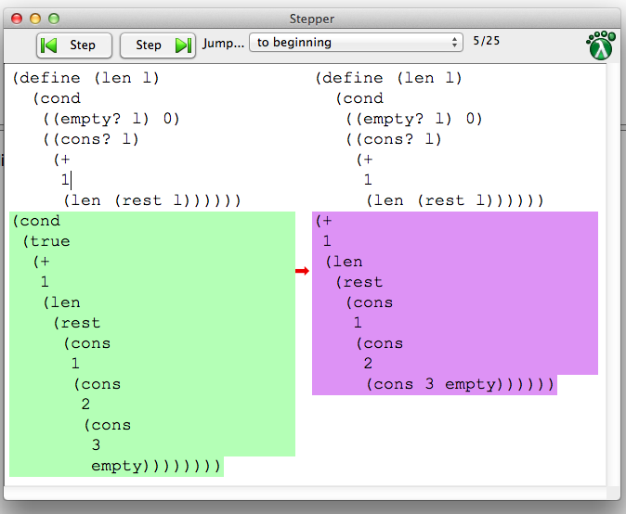
Why We Care
Algebraic stepper (education)
Theorem prover
Template expander
Debugger
Type elaborator

Slide 13
Surface T
desugar
Core T₁
How to present as a surface evaluation sequence?
Core T₂
resugar
Core T₃
Core T₄

Slide 14
not(true) or true
desugar
let t = not(true) in
if t then t else true
eval not(true)
let t = false in
if t then t else true
substitute t
if false
then false else true
evaluate if
true

Slide 15
not(true) or true
desugar
let t = not(true) in
if t then t else true
Abstraction
Show a sugar precisely when the programmer actually used it
let t = false in
if t then t else true
let t = false in
if t then t else true
if false
then false else true
true

Slide 16
not(true) or true
desugar
let t = not(true) in
if t then t else true
Coverage
Show as many steps as possible
let t = false in
if t then t else true
if false
then false else true
true
true

Slide 17
not(true) or true
desugar
let t = not(true) in
if t then t else true
Emulation
Each surface term must desugar to the core term it purports to represent
false or true or true
let t = false in
if t then t else true
if false
then false else true
true
true

Slide 18
How It Works
Run desugaring “in reverse”: Match RHS of pattern against term, rewrite to LHS of term
Avoid terms like using tags
CPS/ANF track state of execution
let t = false in
if t then t else true

Slide 19
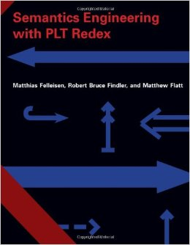
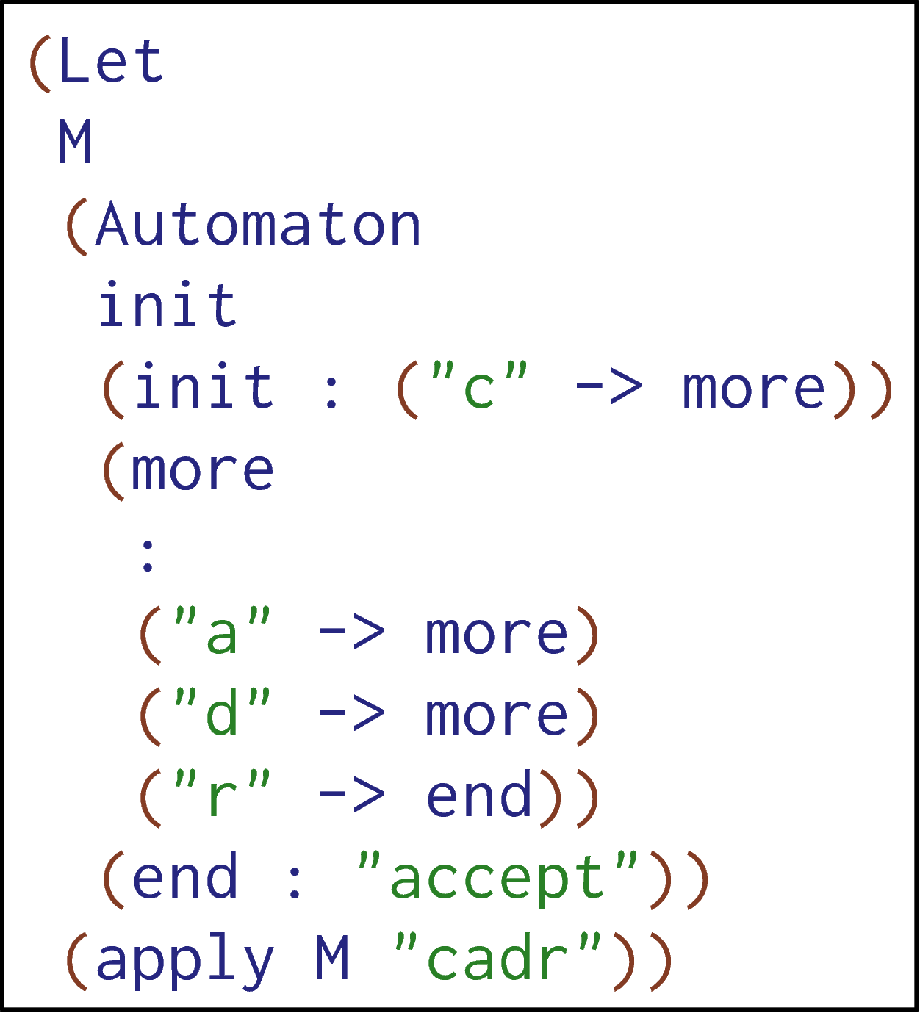
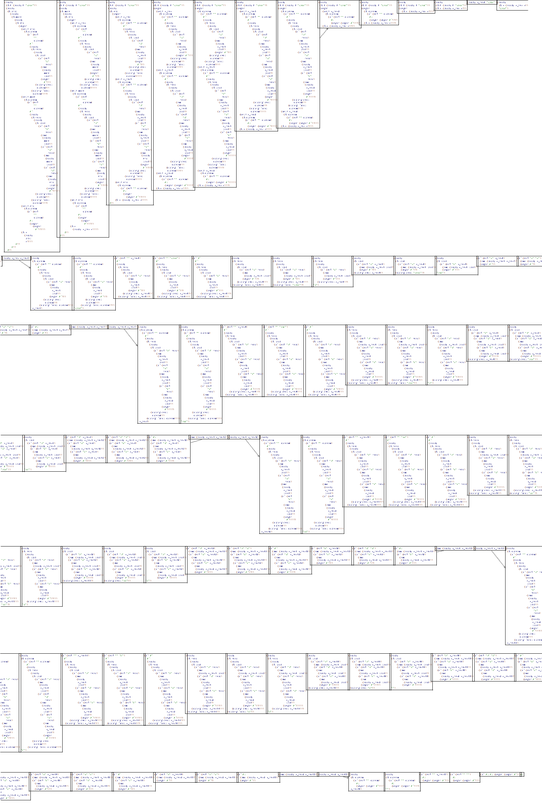
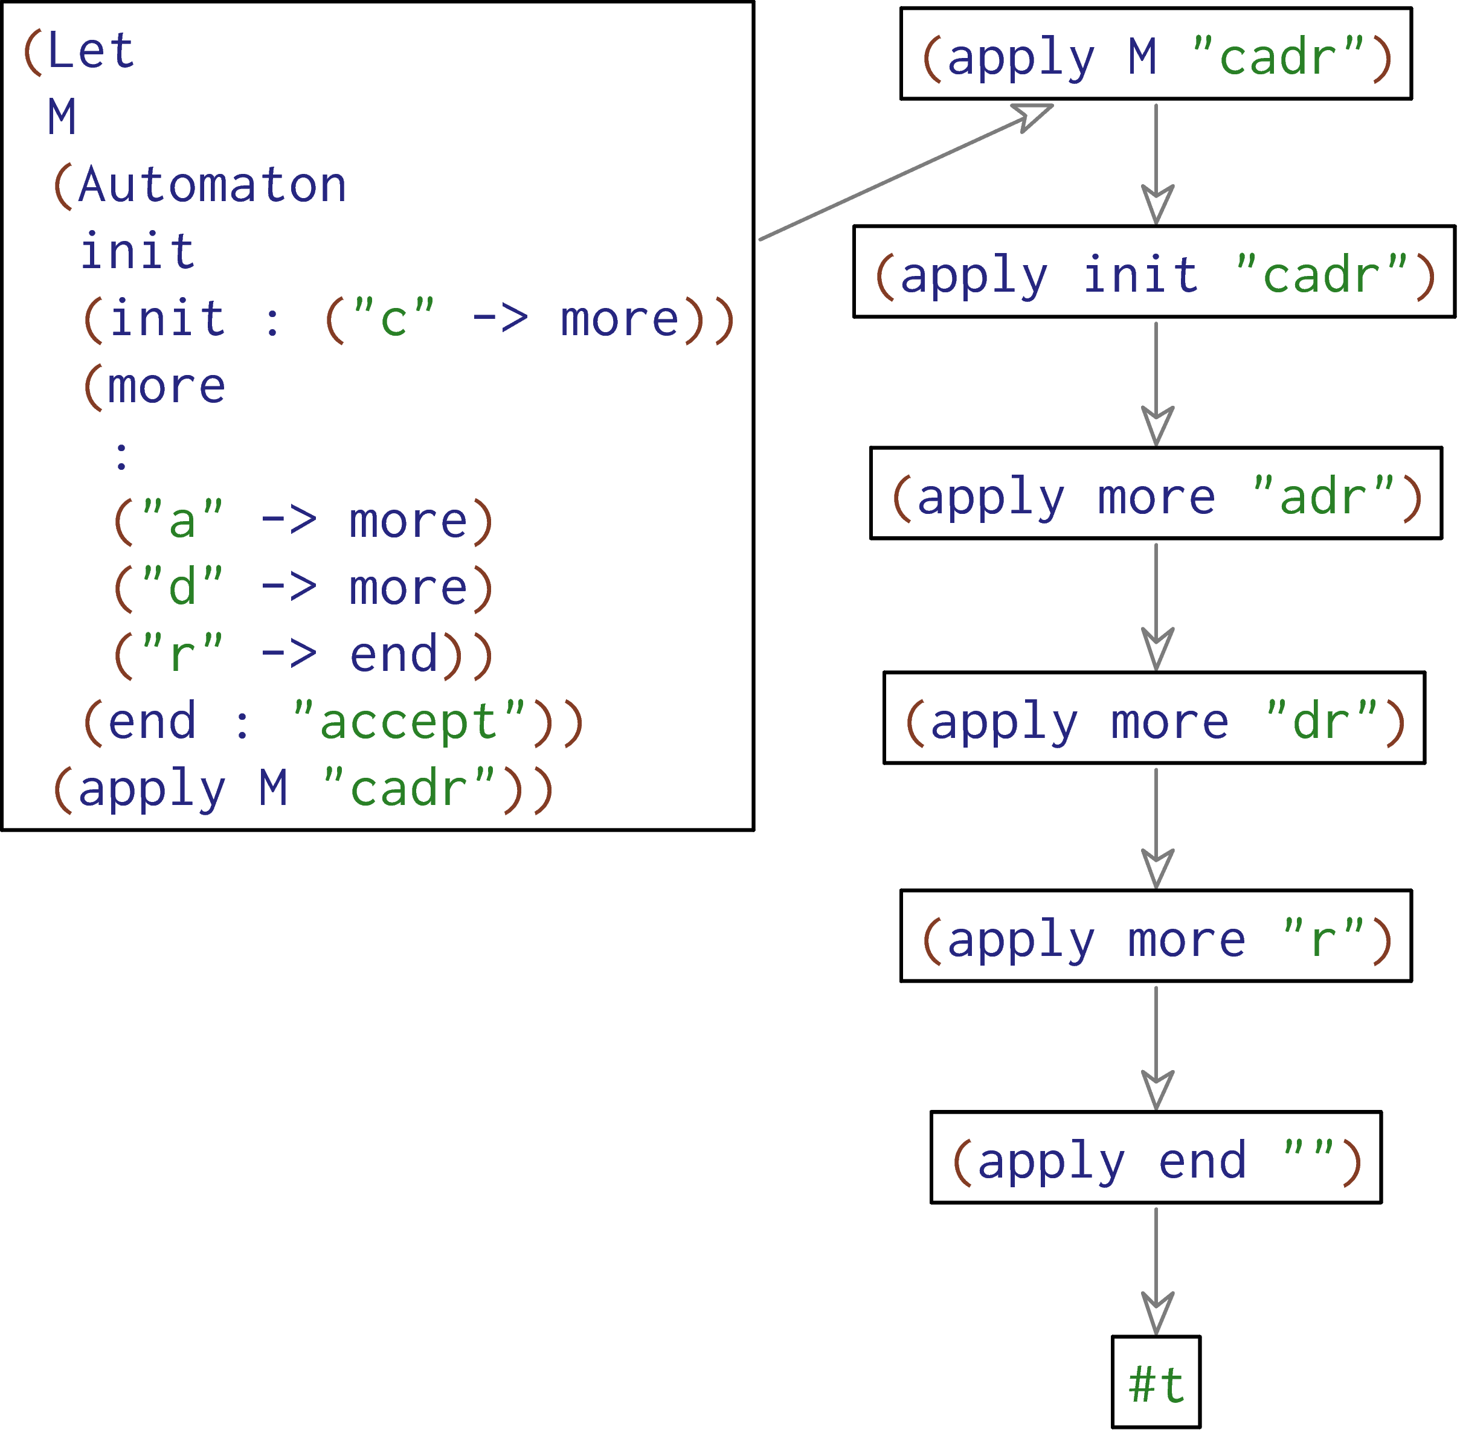

Slide 20
my-list = [2]
cases(List) my-list:
| empty() => print("empty")
| link(something, _) =>
print("not empty")
end
desugar
my-list = list.["link"](2, list.["empty"])
block:
tempMODRIOUJ :: List = my-list
tempMODRIOUJ.["_match"]({
"empty" : fun(): print("empty") end,
"link" : fun(something, _):
print("not empty") end
},
fun(): raise("cases: no cases matched") end)
end
my-list = [2]
cases(List) my-list:
| empty() => print("empty")
| link(something, _) =>
print("not empty")
end
16 steps later…
cases(List) [2]:
| empty() => print("empty")
| link(something, _) =>
print("not empty")
end
"not empty"
<func>("not empty")
"not empty"
Notes:
Say: this was an old version of Pyret, back when it was simple and written in Racket. Resugaring for current Pyret: upcoming.

Slide 21
Thesis Statement
Many aspects of programming languages—in particular evaluation steps, scope rules, and type rules—can be non-trivially resugared from core to surface language, restoring the abstraction provided by syntactic sugar.

Slide 22
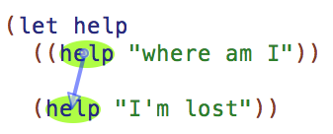
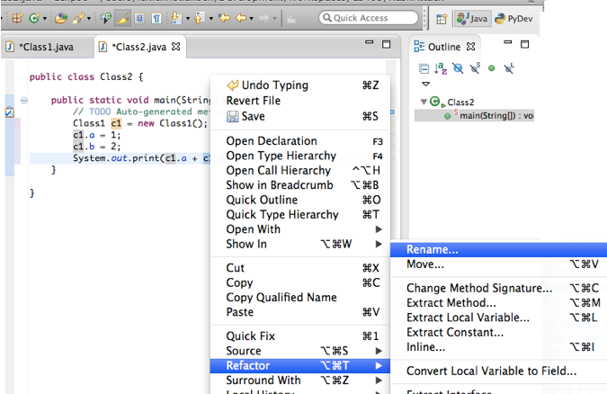
Why We Care

Slide 23
Must be distinct?
name shadows x?
x shadows name?
laborious
&
error-prone
Must be distinct!
?
(named-lambda name (x ...) body)
Within body, name is bound to the function.
Notes:
Attribution: macro from Alexandria project

Slide 24


Pyret
Haskell
Scheme
R5RS
~500 lines
(mostly core scope rules)
for-loop
let-clustering
function decls
list comprehs:
-guards
-generators
-local bindings
let
let*
letrec
do
4ms

Slide 25
Thesis Statement
Many aspects of programming languages—in particular evaluation steps, scope rules, and type rules—can be non-trivially resugared from core to surface language, restoring the abstraction provided by syntactic sugar.
Generate type rules for surface language given type rules for core and sugar defs.

Slide 26
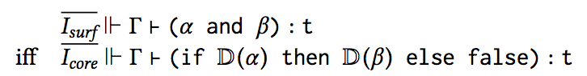
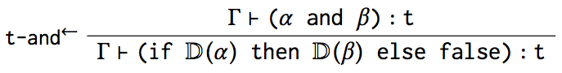
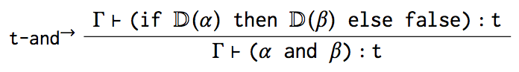
Not very useful
Interesting part

Slide 27
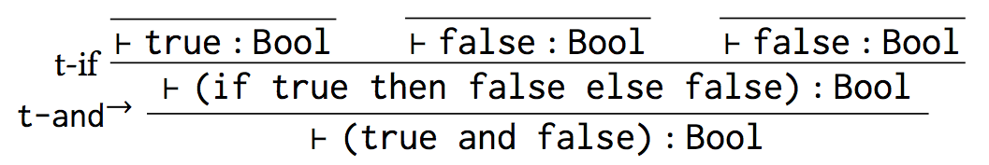
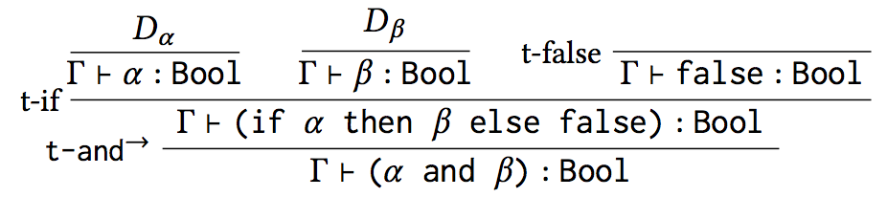
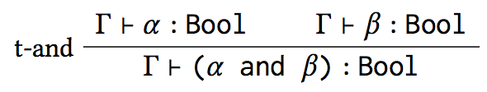

Slide 28
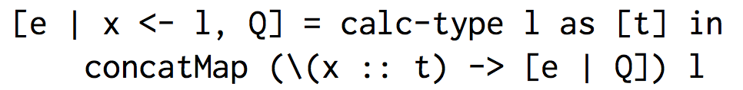
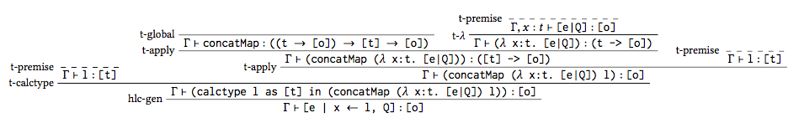

Slide 29
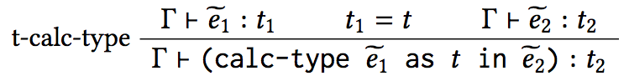

Slide 30
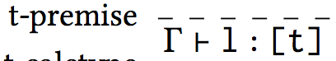
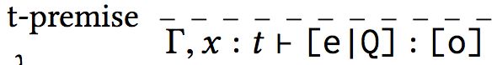
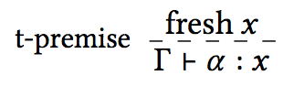
any surface term

Slide 31
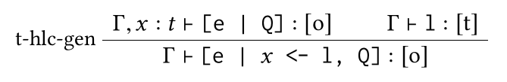

Slide 32
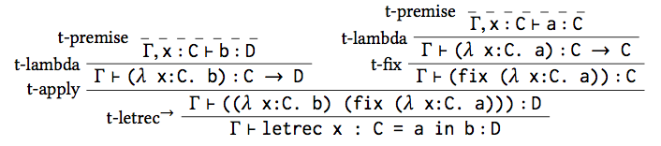
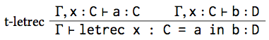
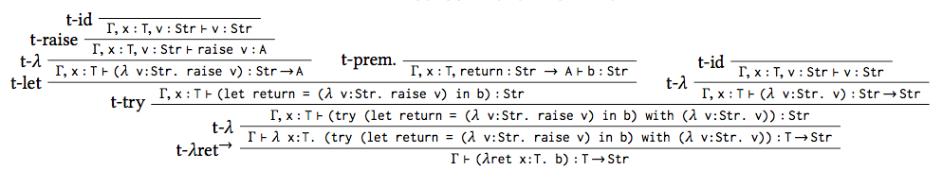
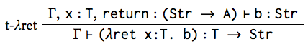

Slide 35
Scope Resugaring
Automatically infer language scope rules
scope as a preorder
binding language
scope inference
reformulation of hygiene
with Mitch Wand

Slide 36
Desugaring in Perspective

Slide 37
The View from the 1990s
Macro systems are for
C
a bad hack that complicates debugging
C++ (templates)
a clever hack leading to painful errors
Lispy languages
(a ((fringe)) (((idea))))
An untouchable idea!

Slide 38




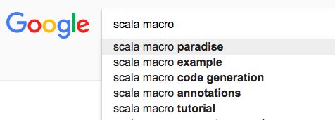

Today

Slide 39
Desugaring is Everywhere
Desugaring in languages on the rise
Desugaring for languages is widespread
Tested semantics is a growing trend

Slide 40

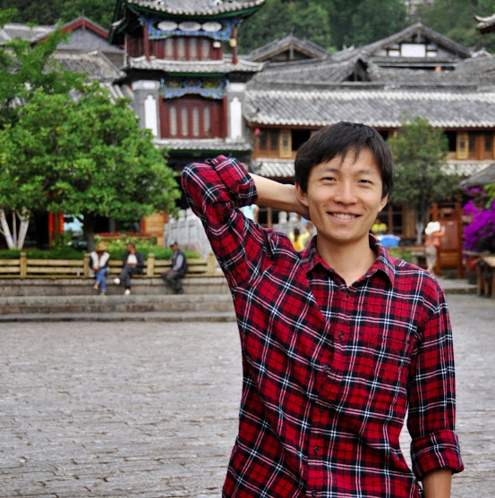

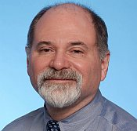
Resugaring: Lifting Evaluation Sequences through Syntactic Sugar PLDI 2014
Hygienic Resugaring of Compositional Desugaring ICFP 2015
Slimming Languages by Reducing Sugar: A Case for Semantics-Altering Transformations Onward! 2015
Inferring Scope through Syntactic Sugar ICFP 2017
Inferring Type Rules for Syntactic Sugar PLDI 2018
Justin Pombrio
Junsong Li
Joe Politz
Ben Lerner
Liam Elberty
Mitch Wand

